Slide 1
Henry Joseph Round
1881-1966

Slide 2
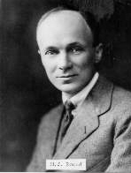

Slide 3
1902 Joined Marconi Company
1902-1907 USA, N.I. & Brazil
1908 Portable wavemeter
1909 Decremeter
1910 Direction Finding
1910 Crystals and valves
1913 Three electrode soft valve.

Slide 4
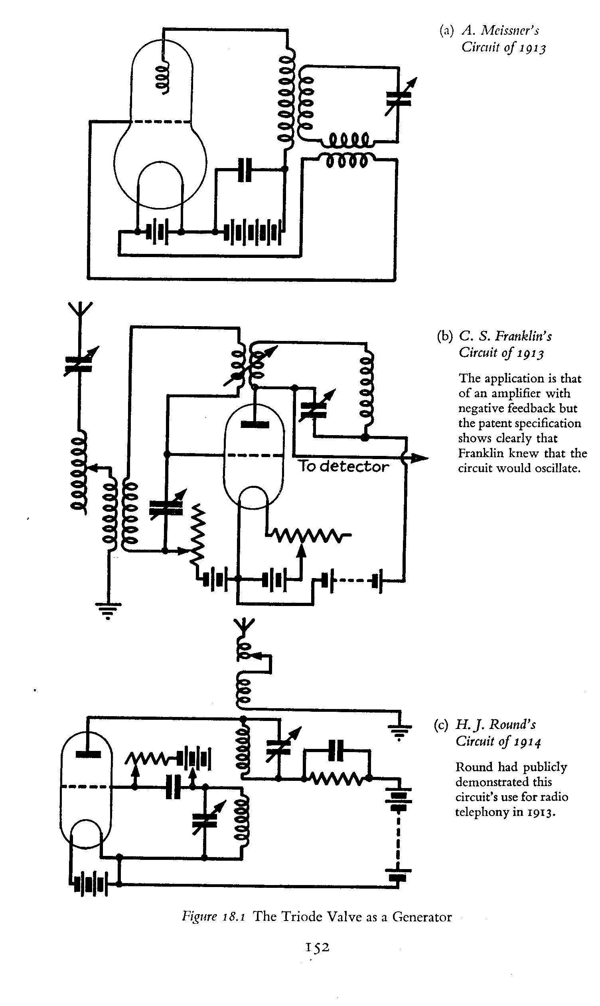

Slide 5
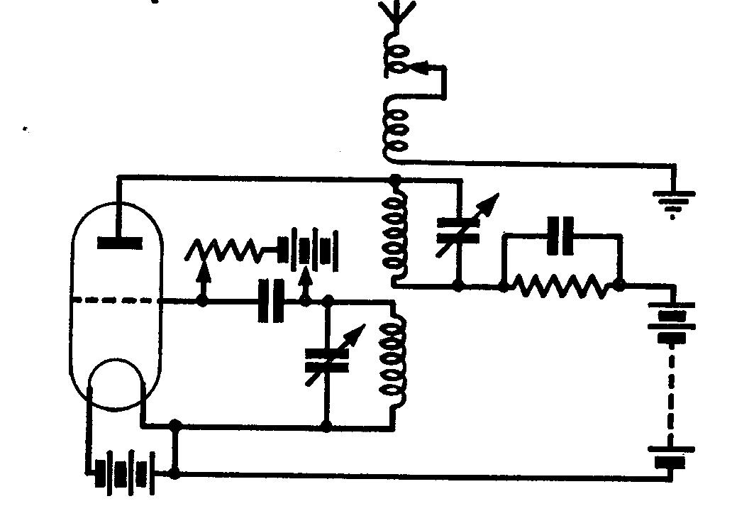

Slide 6
1902 Joined Marconi Company
1902-1907 USA, N.I. & Brazil
1908 Portable wavemeter
1909 Decremeter
1910 Direction Finding
1910 Crystals and valves
1913 Three electrode soft valve.

Slide 7
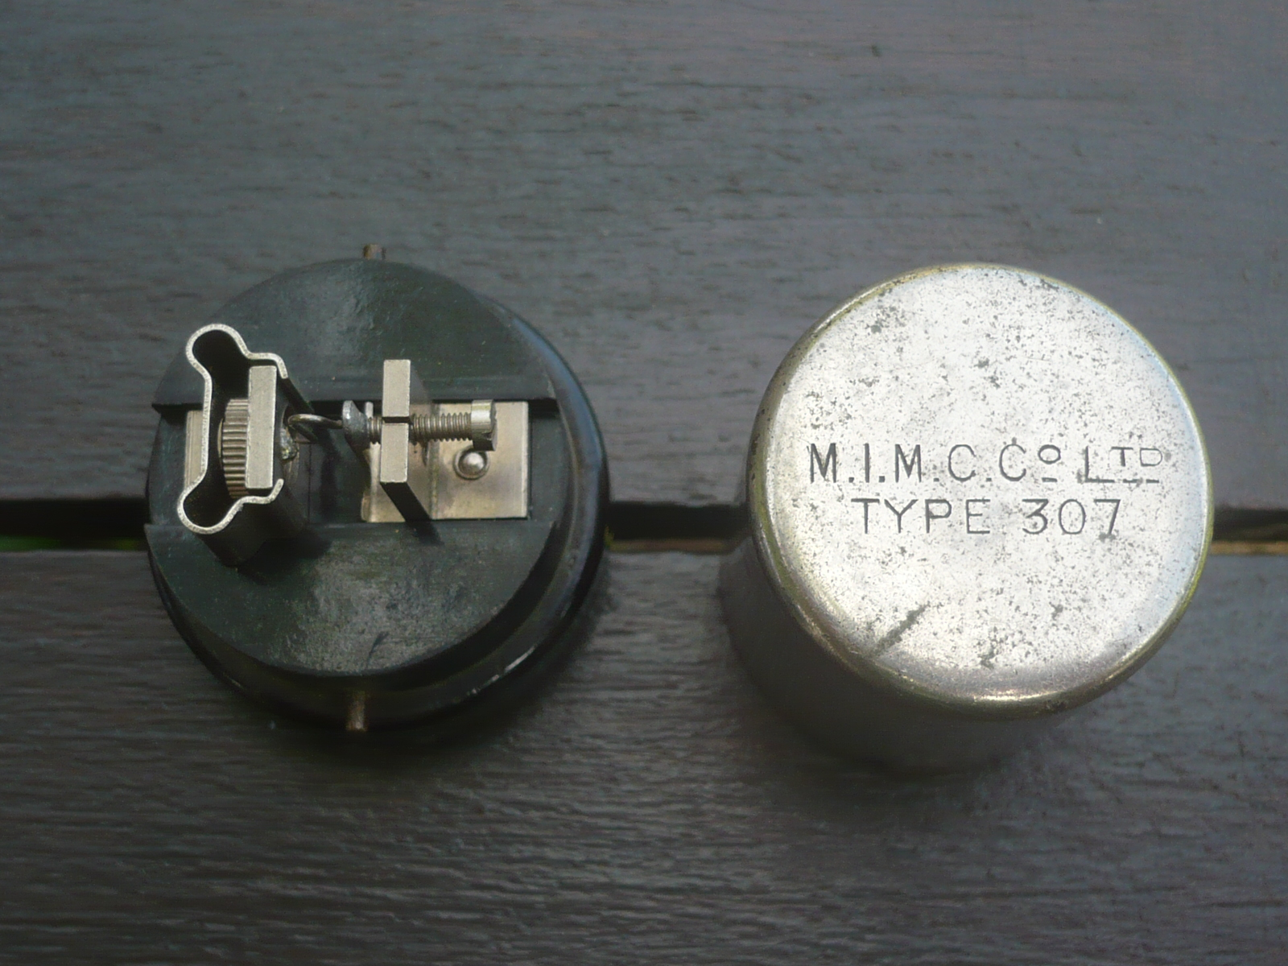

Slide 8
1902 Joined Marconi Company
1902-1907 USA, N.I. & Brazil
1908 Portable wavemeter
1909 Decremeter
1910 Direction Finding
1910 Crystals and valves
1913 Three electrode soft valve.

Slide 9
1914 Patent C valve
1914 1st telephony between ships.
1914 Military Intelligence – Captain
1914 Set up Direction Finding stations
1915 V-24 & Q valves
1917 Rotating frame DF circuits.

Slide 10
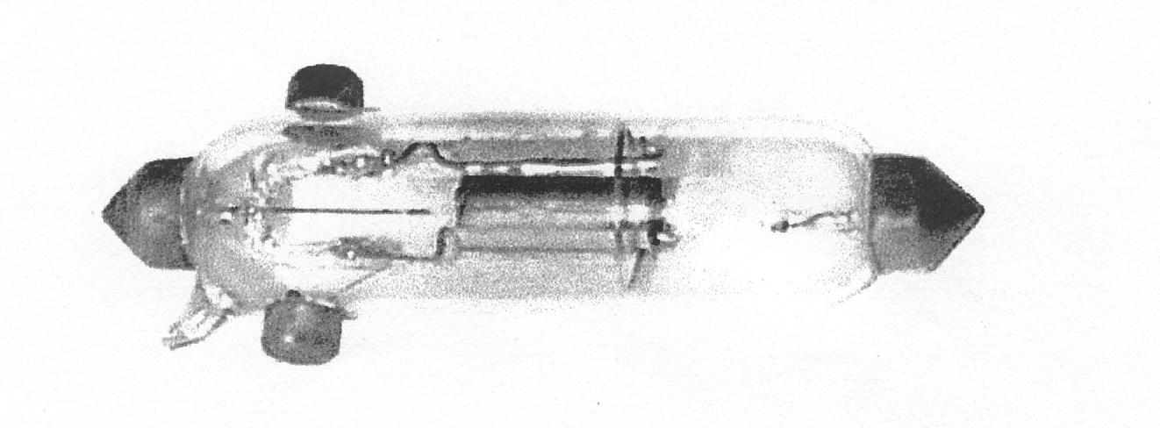

Slide 11
Wireless on land.
Direction Finding.
Artillery
Interception.
Mobility/
Loos September 1915.

Slide 12
Wireless in the air.
RFC
Brooklands. Dartford. Joyce Green. Biggin Hill.
Airships. Hydrophones.
Weight and Aerial problems.
RAF April 1918.
Battle of Messines.

Slide 13
Wireless at Sea.
DF stations
1910 Admiralty station at Whitehall
Intership and ships/hore communications.
South Foreland and East coast stations.
Battle of Jutland.
Sir. Henry Jackson.

Slide 14
Military Cross
Chief Researcher and Engineer Marconi Company
V-24 in use until 1937
WW II - Admiralty.
ASDIC/SONAR

Slide 15
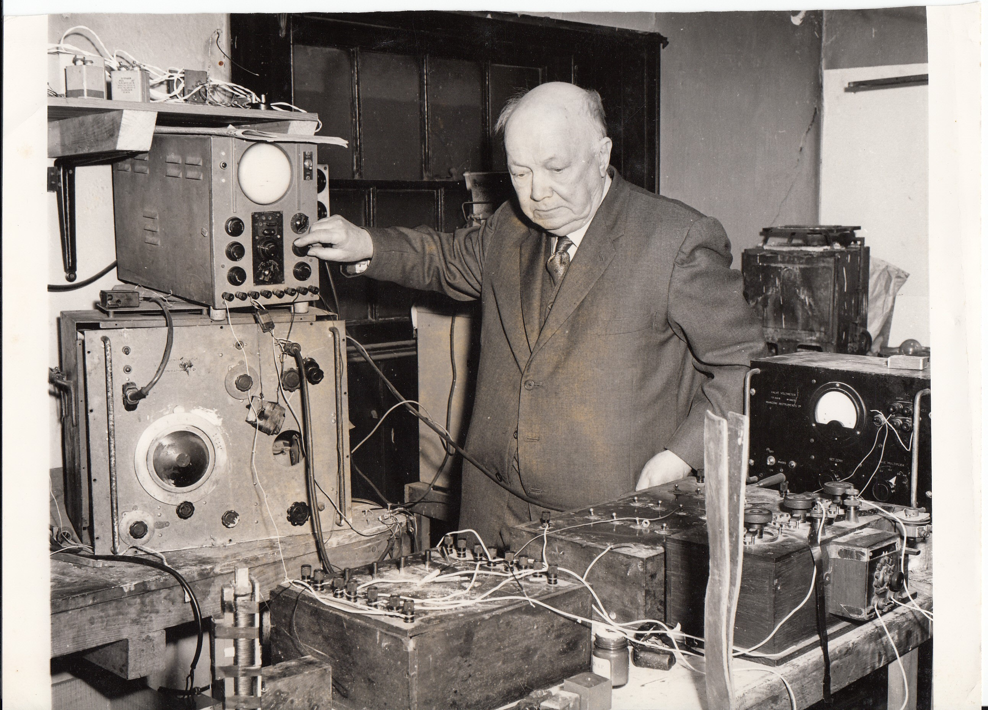
Picture courtesy Marconi Company

Slide 16
They dying so we live

