Slide 1
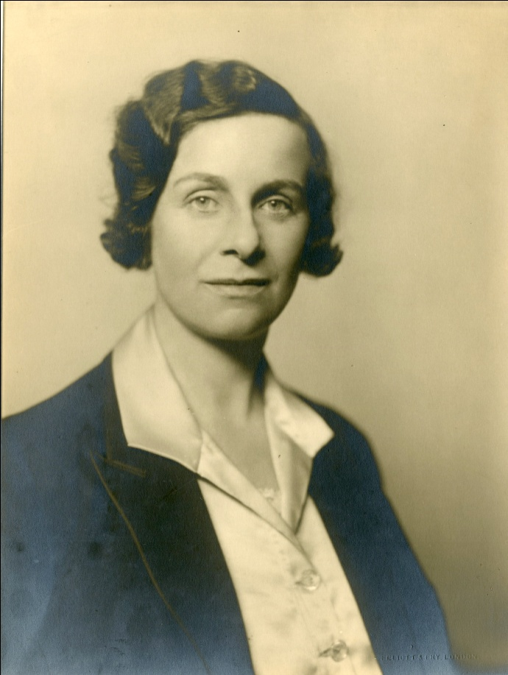
Engineering opportunities
Women and technology in the First World War and beyond

Slide 2
Collections in the IET Archives
Contemporary papers and accounts of technology
London Electrical Engineers (Volunteers): collections and connections with IET members
Women’s Engineering Society (founded 1919): anecdotal evidence

Slide 3
Plans for 2014 and beyond
Support for research projects
Joint exhibition with IMechE and ICE on women in the First World War
Commemoration of Hertha Ayrton’s work – the ‘Ayrton Fan’
Foundation of WES 1919

Slide 4
Women in technical roles in WW1
Women employed in technical capacities
Munitions and transportation: semi-skilled roles but with the chance to gain new skills
Evidence in IET Archives: mostly anecdotal and/or post-1920

Slide 5
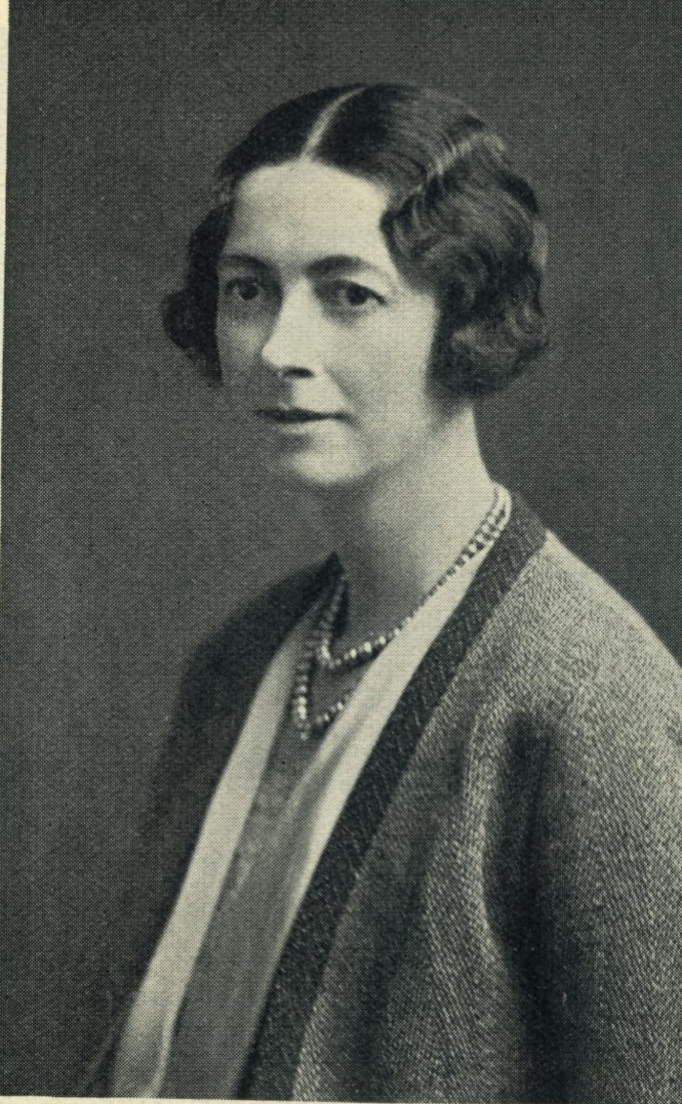
Case study 1: Verena Holmes

Slide 6
“… the War gave her her chance. In 1916 she first entered an engineering workshop, and felt at once that this was her proper sphere…”
“You will not have a chance after the war; the trades unions will be against it. If you must be an engineer you had better go into the shops now.”
(The Woman Engineer 1930)

Slide 7
Engineering education
Worked on aeroplane parts at Integral Propellor Company Hendon
Ruston and Hornsby, Lincoln – promoted to superintendent of women
Engineering apprentice in shops until 1919
Drawing office
Loughborough College: practical experience and BSc (Eng) in 1922

Slide 8
Career developments and difficulties
No long-term jobs available in UK or US
Inventions and designs including safety guillotine
Marine and locomotive engines
First woman member of IMechE and ILocoE
One rejection from IMechE and 20 years until MIMechE

Slide 9
Education and public work
Engineering education for girls and young women
Holmes and Leather founded 1946: employed women engineers
WW2: advised on women and munitions

Slide 10
Case study 2: Hertha Ayrton
Born Phoebe Sarah Marks
Mother championed her education and sent her to cousin Marion Herzog’s school
Influence of Barbara Bodichon
Girton 1877-1881

Slide 11
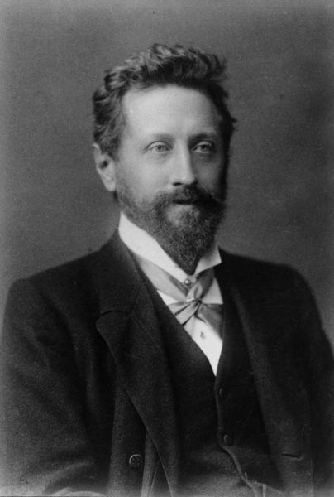
Marriage, motherhood and research
Finsbury Technical College and marriage
Legacy from Barbara Bodichon 1891
1893: research into electric arc
1899: IEE paper and elected Member

Slide 12
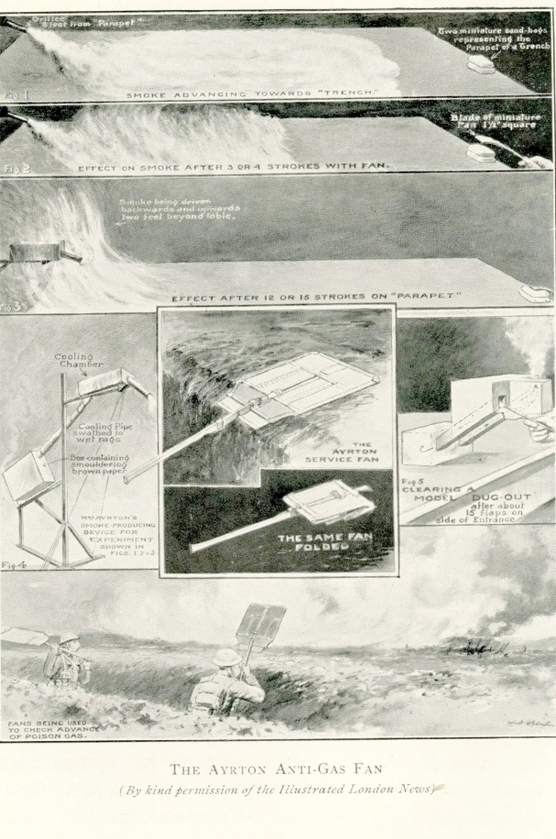
Further scientific research
Sand ripples
Proposal for Fellowship of the Royal Society 1902
Hughes Medal 1906
Air oscilliation research led to development of Ayrton fan -

Slide 13
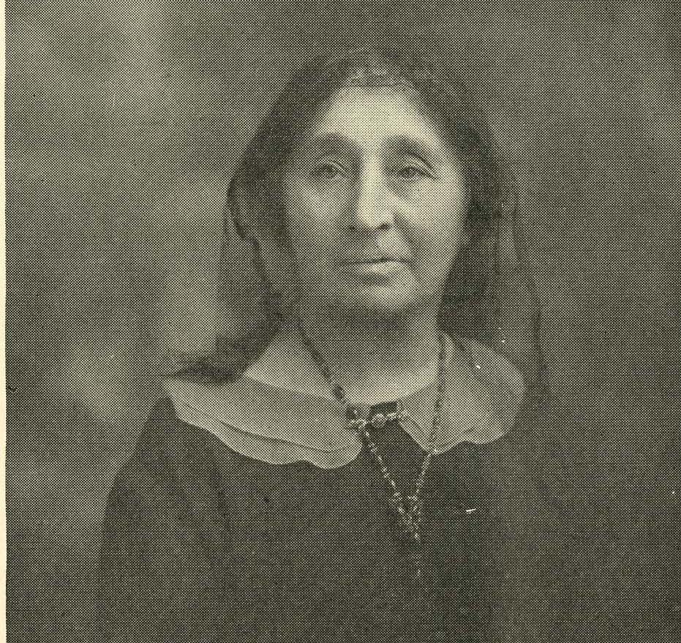
Post war experiences: foundation of WES
Founded by Lady Parsons 1919
Professional women engineers and technicians
Education and peer support

Slide 14
